Slide 1
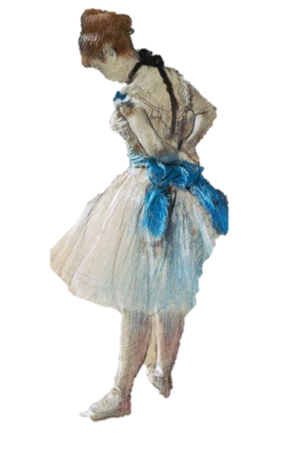
Impressionism
Monet
&
Degas

Slide 2
Brief History
Impressionism was a hugely influential art movement in the 19th-century.
Impressionist paintings were revolutionary in their time.
They deviated from classic, fantastical scenes to portray real life with a broken brushstroke technique that emphasized the general impression of a scene.
In the 1860's, a group of French painters rejected the current ideas about painting. They tried to free themselves of rules and traditions and to portray their immediate impression.
These painters attempted to achieve a convincing depiction of the light in their landscapes, townscapes and portraits. With loose, short strokes of the brush or with dabs of unmixed paints they recorded their impressions on the canvas.
From a distance, the loose combination of brush strokes merge to form the whole picture.

Slide 3
Style Features
Loose, visible brushstrokes
General impression
Emphasis on light and its changing qualities
Ordinary subject matter
Pure, intense colours
hatching, cross-hatching, stippling, drybrushing, and sgraffito were used to blend
Spontaneous (portrayed as if the viewer has just seen it in passing, a glimpse)
Paints were mixed on the canvas rather than on the palette, and applied in short, thick strokes
Not very realistic from close up
Need to step back to see the whole picture

Slide 4
Edgar Degas (July 19, 1834 – Sept. 27, 1917)
Degas is viewed as an impressionist, and exhibited his art in the 1870s, around the time impressionism started.
While Degas shared many techniques associated with impressionism such as capturing the effects of light, he rejected the label and preferred to describe himself as independent from it, preferring to think of himself as more of a realist.
There are several things that set him apart from other impressionists. -This included his intrigue in the human body. Where most impressionists preferred to draw outdoor scenes, Degas focused more on drawing people doing everyday things. He has many paintings depicting ballerinas, dancers, and other women in unusual positions.
Degas came from a rich family, and didn’t have to make a living with his art, enabling him to experiment and branch out with his style, causing his pieces to be different from other impressionists.
He tends to put more detail in his work than most other impressionists.

Slide 5
The Dance Class – Degas (1874)
This painting depicts several young ballerinas in a room in different positions. One dancer performs for Jules Perrot, a renowned ballet teacher. There is a mirror in the background reflecting other dancers.
Commissioned by Jean-Baptiste Faure
Oil on canvas painting
Visible brush strokes in the wood and parts of the dress as well as throughout the rest of the piece
Showing an everyday scene of a dance class rather than a fantastic scene such as a battle or something dramatic
Includes bright, vibrant colours
Sneak peeks to the outside world through the mirror and the guardians at the back of the room

Slide 6
The Orchestra at the Opera – Degas (1870)
Depicts the orchestra in the pit where they play at an opera.
Instead of focusing on what is usually viewed at these events (the singers and the people on stage) it presents the view that isn’t usually seen- the musicians in the pit. It was common to see the debatably mundane or less fantastic, more every day subjects in Impressionism, such as how the main focus is not the stage.
The ballerinas on the stage are cut off from the neck up, and are significantly less detailed than the orchestra.
There is a large contrast between the pit and the stage, especially due to the use of light and colour.
While the piece does have a lot of realism as many of Degas’ works do, there are still distinct brush strokes used as well as a focus of light and colour.

Slide 7
Claude Monet (1840-1926)
Born Oscar Claude Monet
"Everyone discusses my art and pretends to understand, as if it were necessary to understand, when it is simply necessary to love."
Initiator, leader and unswerving advocate of the impressionist style in France
The most consistent artist and practitioner of the philosophy and idea of expressing perception rather than detail, especially applied to landscape painting

Slide 8
Bridge Over a Pond of Waterlilies (1899)
Located at Metropolitan Museum of Art
Oil on canvas
Arched wooden bridge over pond
Waterlilies depicted on the surface of the pond
Clear blue sky partially visible through the trees
Vegetation reflected in the water
Extremely vague, loose brush strokes
Abundance of pure, vibrant colours
No extreme detail
Suggestion of trees

Slide 9
Impressionism, Sunrise (1872)
Located at Musée Marmottan Monet, Paris
Oil on canvas
Harbour of LeHavre, France
Sketched quickly in oil paints on canvas
Portrays the natural light of the moment because it was done so fast
Very spontaneous, done while looking out his window on a spring morning
Sun against the dawn sky (contrast)
Clouds holding the colour of the sun
Boats, fairly undefined
Dark brush strokes to indicate the movement of the water

